Slide 1

Software Architecture
Trivial i1b

Slide 2
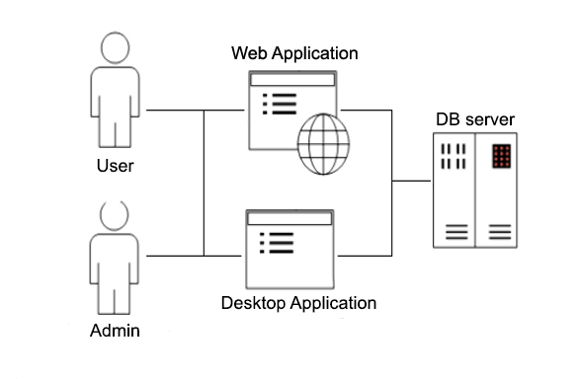
ASW Project
Notes:
The objective of this Project it’s to make a program that has two utilities, to be able to play the trivial game, and as the admin to get information about the users and the games that they play. This functionality it’s going to be the same for the two main applications the desktop one and the web. There’s going to be suport of a DataBase to perform all the necesary persistence.

Slide 3
Objectives
Clearly defined Architecture Style
Use of Attribute Driven Design and Quality Scenarios.
Modularity (between phases, logic, interface… )
Reusability( login between the 2 and 3 part)
Usability. Easy and intuitive interfaces.
Other Quality attributes.

Slide 4
First Deliverable : PARSER
Trivial i1b

Slide 5




Description
Input
Intermediate format
Output
Persistence

Slide 6
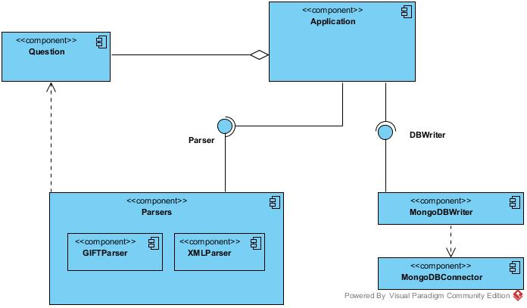
Architecture
Sequential or Batch:
Parser
Processing
Persist
Notes:
Parser lo lleva a cabo parser, pero Processing y Persist lo lleva a cabo DB Writter, que recibe una colección de preguntas y cambia su formato para subirlas a la base de datos.

Slide 7
Quality atributes

Slide 8


Tools and technologies
Continuous integration
Version Control Flow
Persistence
Notes:
Parser lo lleva a cabo parser, pero Processing y Persist lo lleva a cabo DB Writter, que recibe una colección de preguntas y cambia su formato para subirlas a la base de datos.

Slide 9
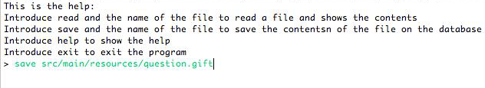
Use example

Slide 10
Second Deliverable : DESKTOP APPLICATION
Trivial i1b

Slide 11
Third Deliverable : WEB APPLICATION
Trivial i1b

